Slide 1
CNN for CV
Course Introduction

Slide 2
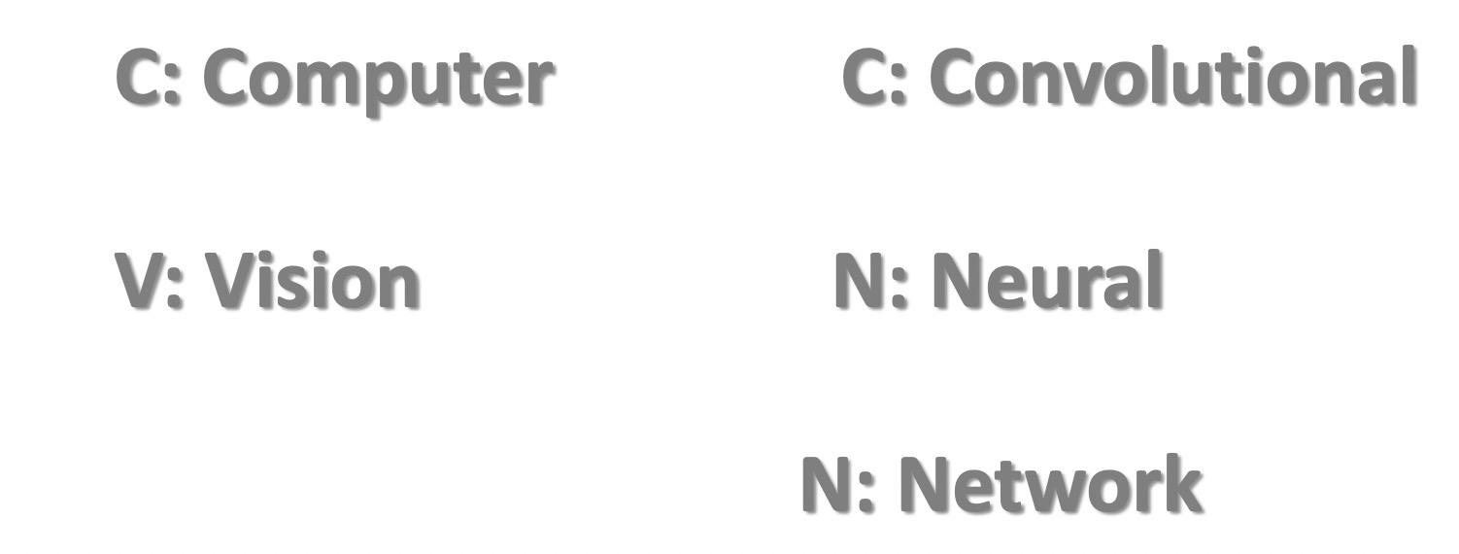
Course Introduction
CNN? & CV?

Slide 3
Course Introduction
CNN? & CV?
福岛邦彦 提出神经认知机
CNN之父 Yann LeCun

Slide 4
Course Introduction
CNN? & CV?
Seymour Prapert

Slide 5
Course Introduction
CNN? & CV?

Slide 6
Course Introduction
CNN? & CV?

Slide 7
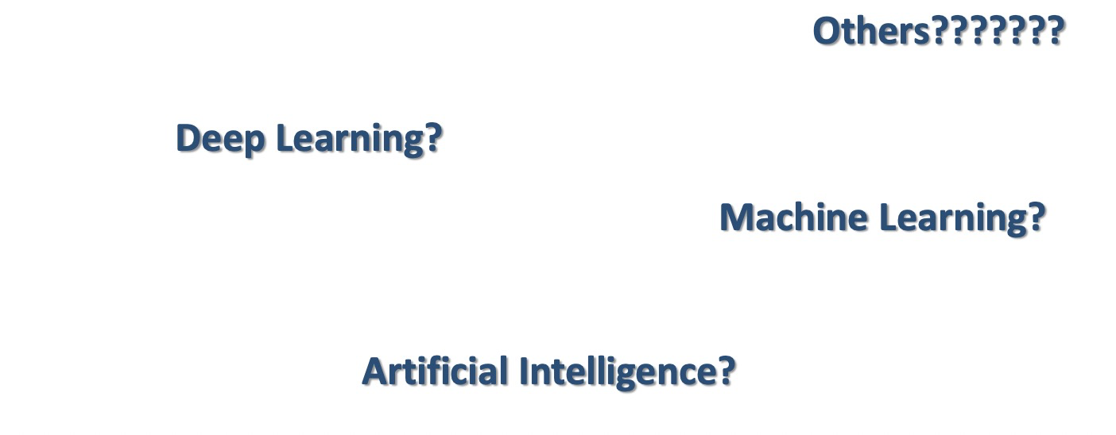
Course Introduction
CNN? & CV?
CNN?

Slide 8
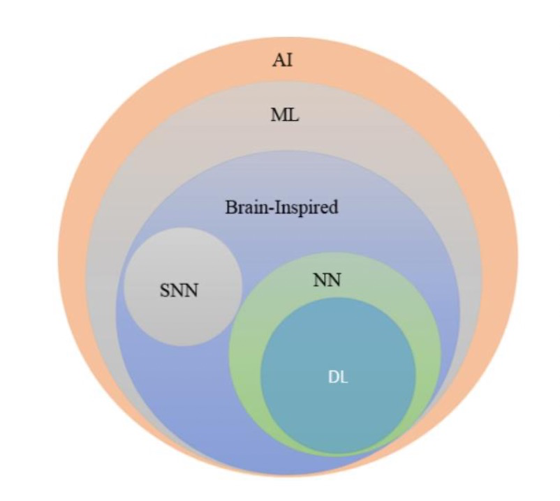
Course Introduction
CNN? & CV?
CNN!

Slide 9
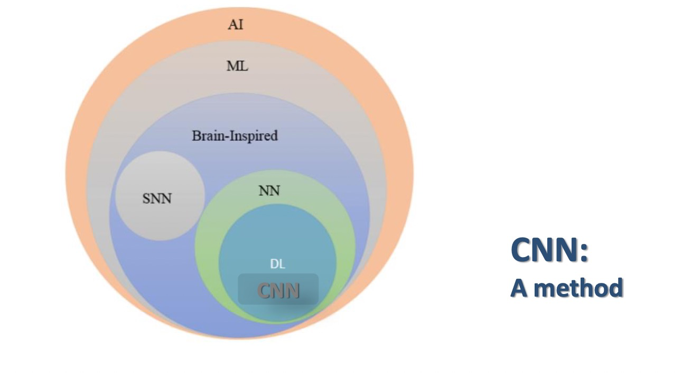
Course Introduction
CNN? & CV?
CNN!

Slide 10
Course Introduction
CNN? & CV?
CNN-Inside?

Slide 11
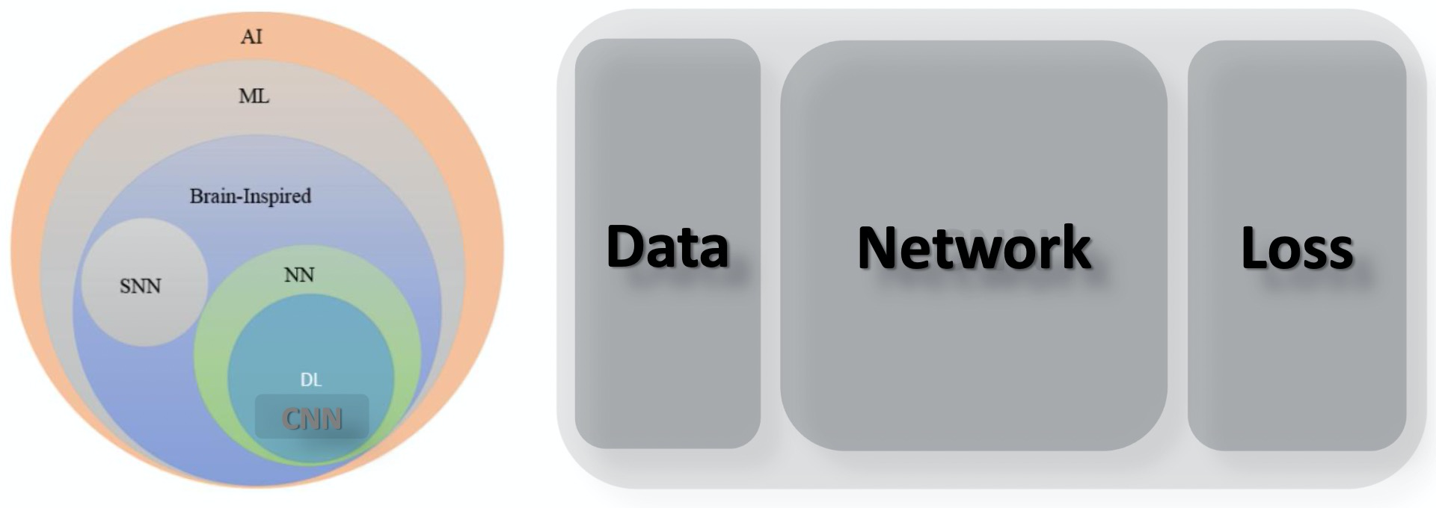
Course Introduction
CNN? & CV?
CNN-Inside?

Slide 12
Course Introduction
CNN? & CV?
CNN-Inside?

Slide 13
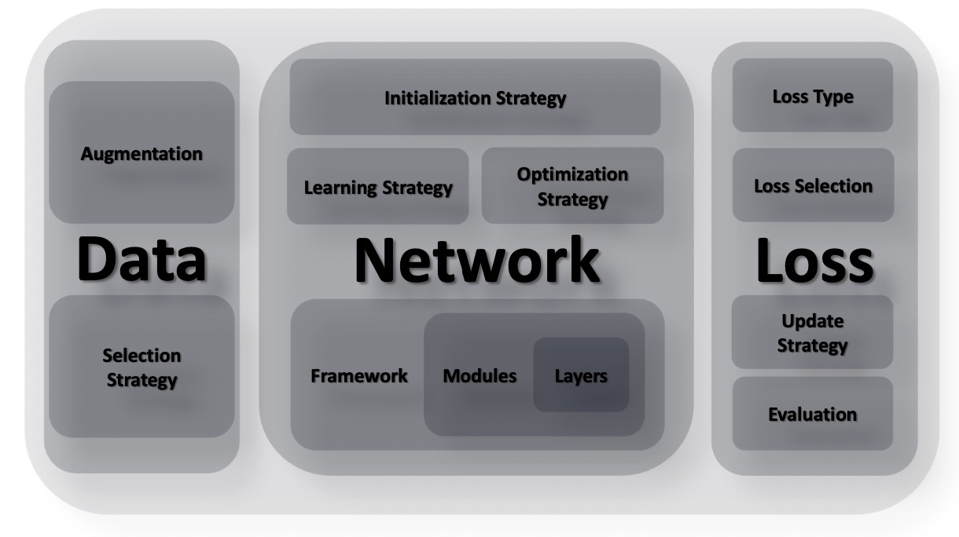
Course Introduction
CNN? & CV?
CNN-Inside?

Slide 14
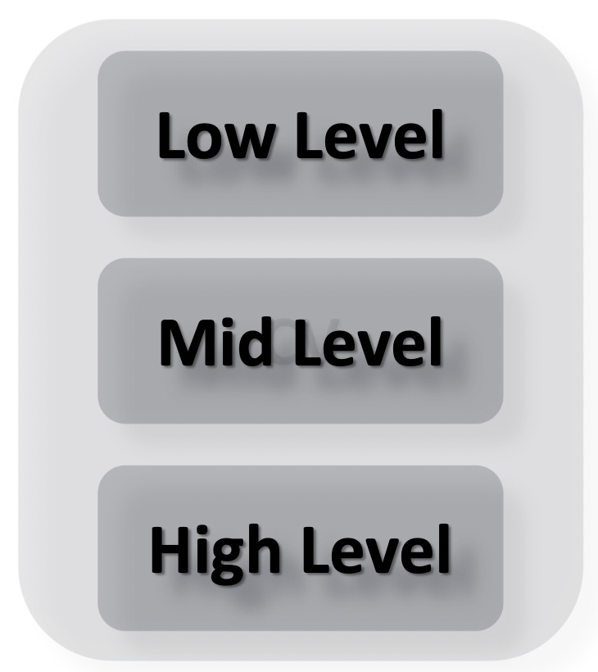
Course Introduction
CNN? & CV?
CV!

Slide 15
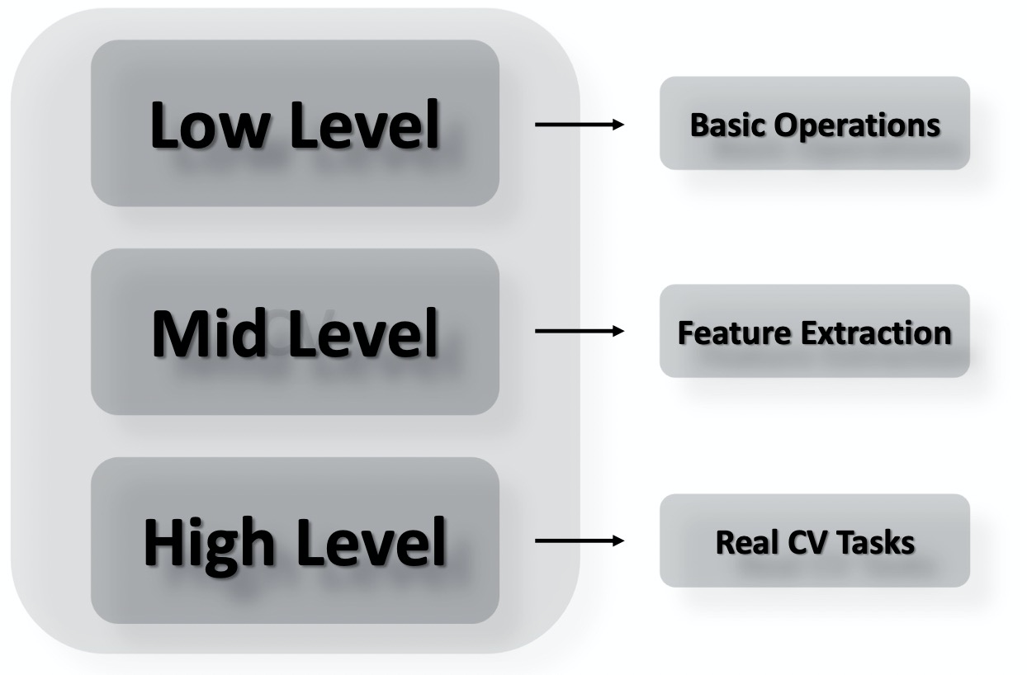
Course Introduction
CNN? & CV?
CV!

Slide 16
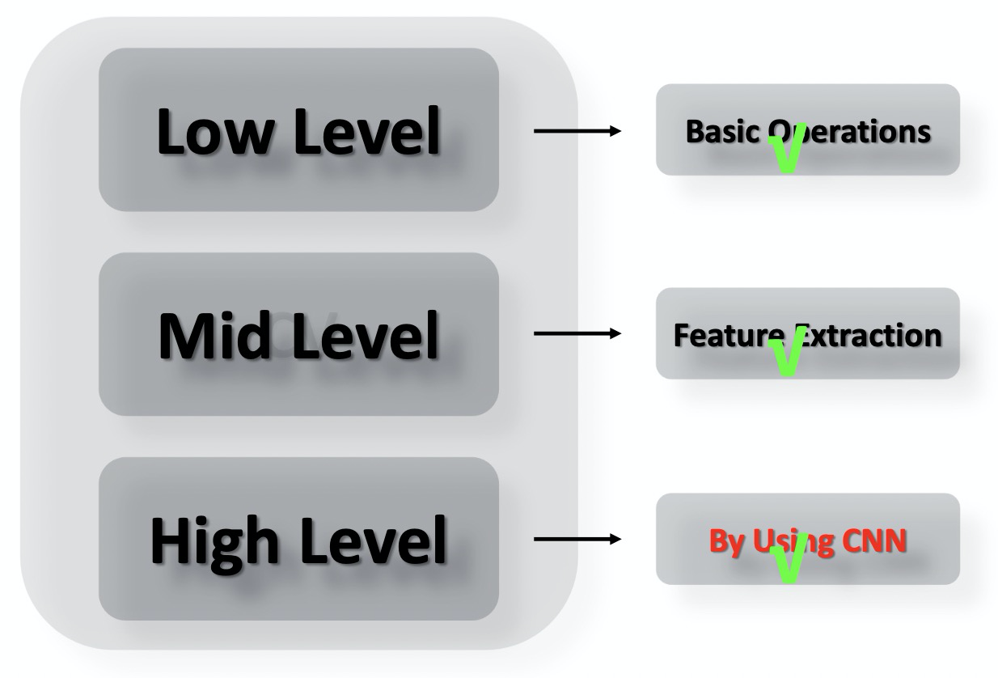
Course Introduction
CNN? & CV?
CV!

Slide 17
Course Introduction
CNN? & CV?
CV!
What Can It Do

Slide 18

Course Introduction
CNN? & CV?
CV!

Slide 19
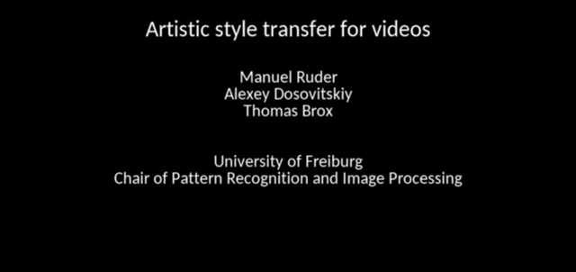
Course Introduction
CNN? & CV?
CV!

Slide 20

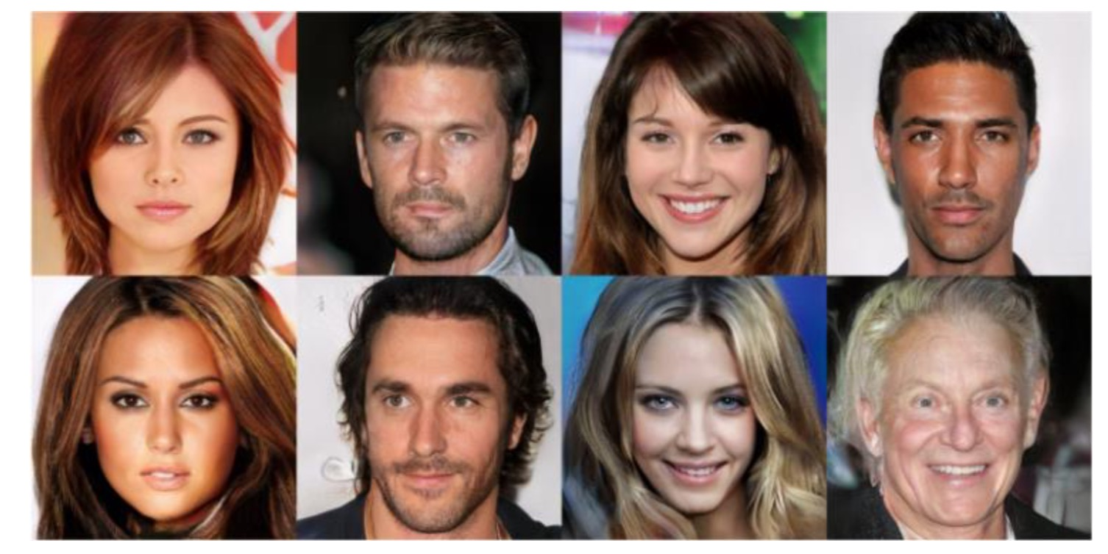
Course Introduction
CNN? & CV?
CV!

Slide 21
Course Introduction
CNN? & CV?
CV!

Slide 22
Course Introduction
CNN? & CV?
CV!

Slide 23
Course Introduction
CNN? & CV?
CV!

Slide 24
Course Introduction
CNN? & CV?
CV!

Slide 25
Course Introduction
CNN? & CV?
CV!

Slide 26
Image Introduction
Low Level Image Processing
Read in (Gray or Color) / Show out
Print out an image
Image data type/shape/crop
Channels / Spaces
Change color (Assignment)
Gamma Correction
Similarity Transform
Affine Transform
Perspective Transform …

